Slide 1
Lecture 27 Two-port Network
Hung-yi Lee

Slide 2
Reference
Chapter 14.1, 14.2, 14.3 (out of the scope)

Slide 3
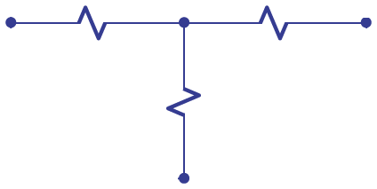
Two and Three Terminal Networks
i
Circuit
Circuit
+
Two-Terminal
Network
v
Three-Terminal
Network
-
i
Chapter 2
Chapter 4.6

Slide 4
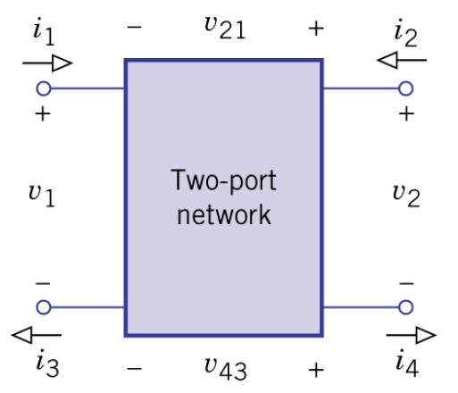
Four Terminal Network
i₁ = i₃
i₂ = i₄
Input port
Output port
4 parameters: i₁, v₂, i₂, v₂
(E.g. Filter)

Slide 5
Two-Port Network
Is it a two-port network?
i₁₂
i₁
i₁₁
i₂
i₁
i₂
Is it a two-port network?

Slide 6
Note
Two-port network can be expressed by the phasor notation.
A two-port network contains no independent sources, although it may contain controlled sources.

Slide 7
i-v characteristics
Z parameters:

Slide 8
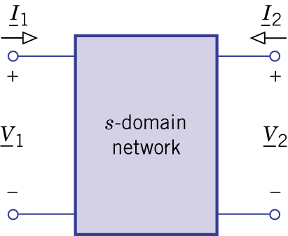
Z parameters
Superposition Principle:
Any current (or voltage) for an element is the weighted sum of the voltage (or current) of the sources.

Slide 9
Z parameters
How to find the Z parameters?
Set
Set

Slide 10
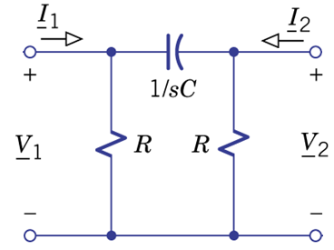
Z parameters – Example 14.1
Set

Slide 11
Z parameters – Example 14.1
Set
Find z₁₁ and z₂₁……
symmetric

Slide 12
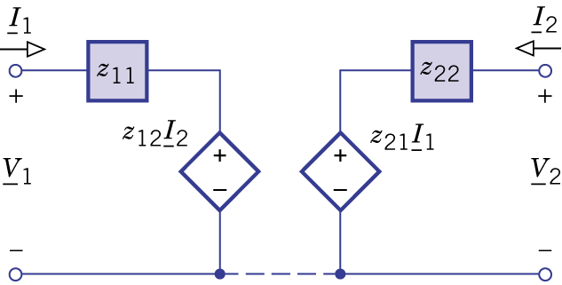
Equivalent Two Port Network
Two Impedances,
Two controlled sources
Three Impedances,
One controlled source

Slide 13
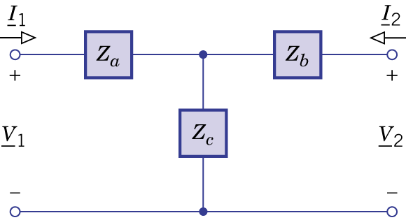
Equivalent Two Port Network
Tee Network
Set
Set
Reciprocal
Network

Slide 14
Equivalent Two Port Network
Tee Network
Reciprocal Network

Slide 15
Equivalent Two Port Network

Slide 16
Other kinds of Parameters
Z parameters:
y parameters:
The y parameters does not always exist.
[z] is not always invertible.

Slide 17
6 kinds of Parameters
z parameters:
h parameters:
T parameters:
y parameters:
g parameters:
t parameters:
Be careful!

Slide 18
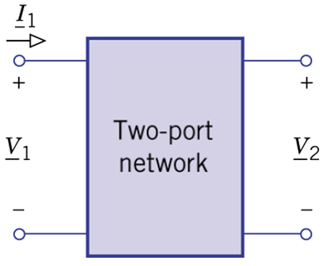
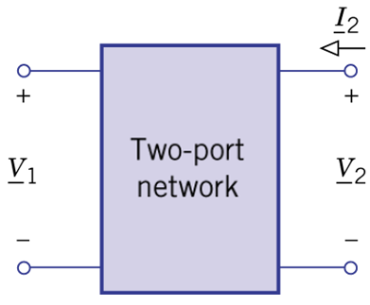
T/t Parameters
T/t for transmission
For T Parameters
For t Parameters
Notes:
Small t is the same

Slide 19
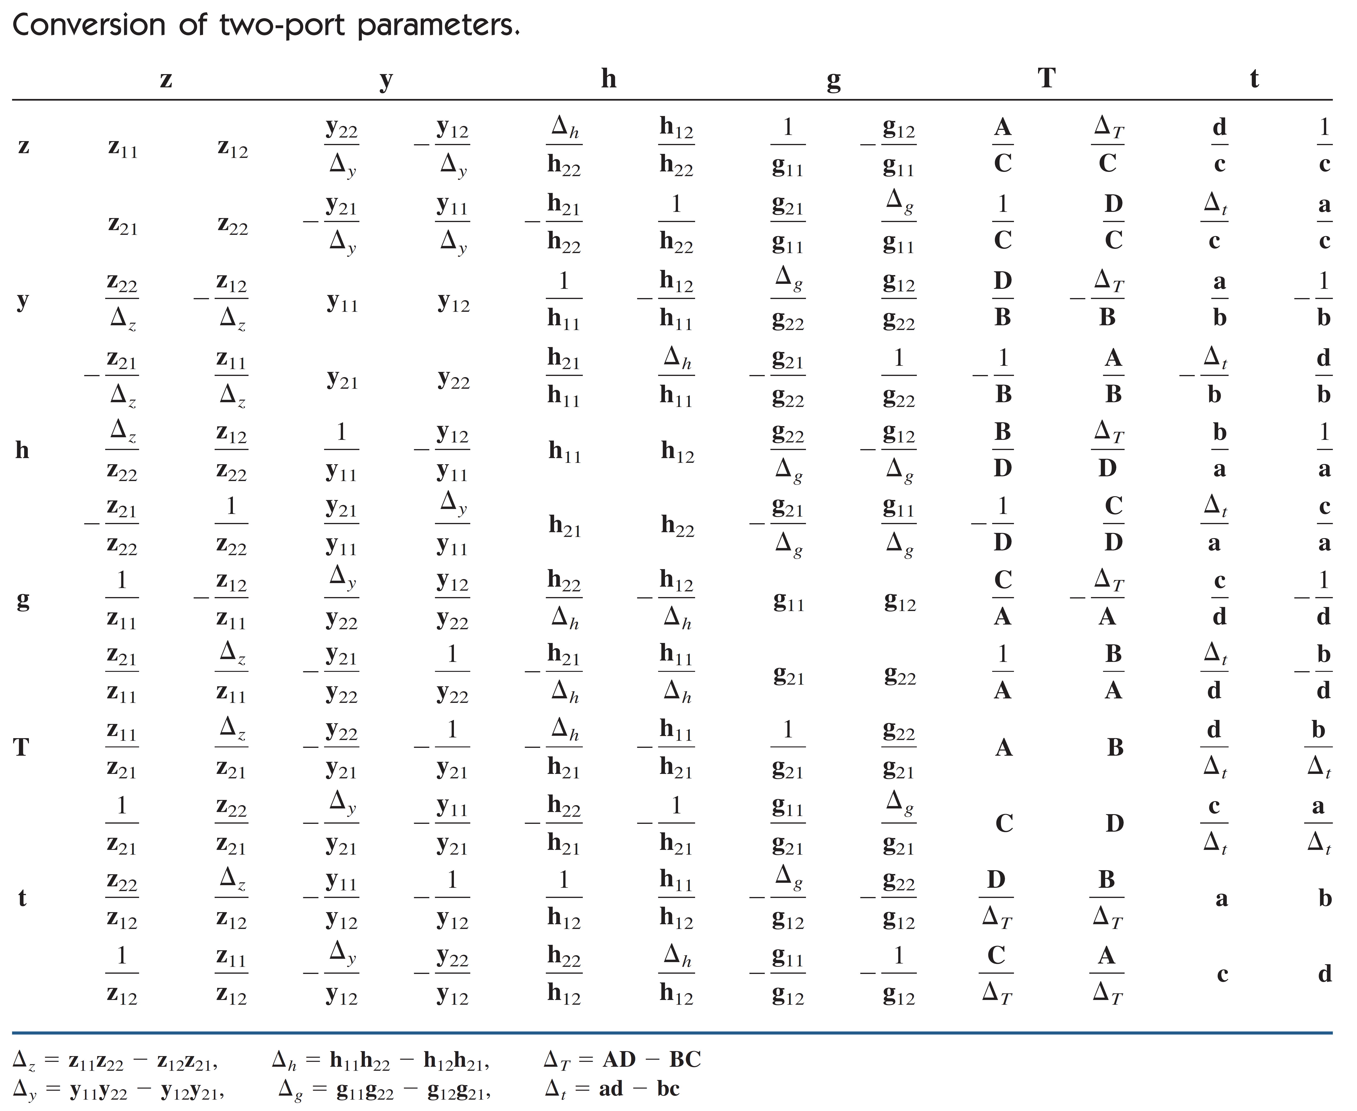
Notes:
How to use this chart?

Slide 20
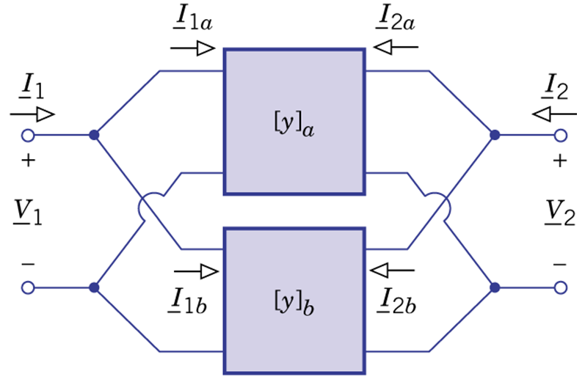
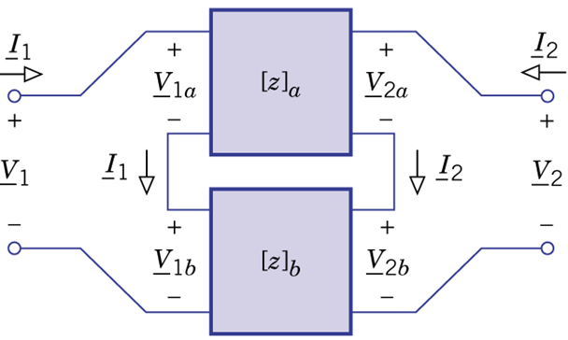
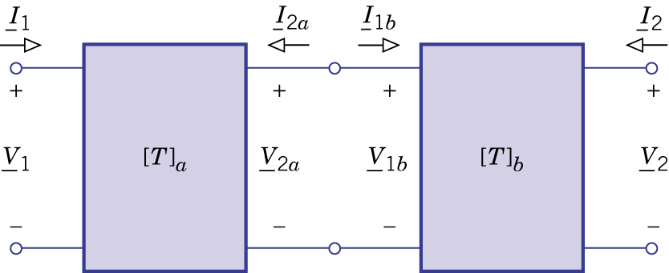
Connecting the Two-port Networks
Parallel Connection:
Series Connection:
Cascade Connection:

Slide 21
Parallel Connection

Slide 22
Parallel Connection

Slide 23
Parallel Connection - Note
Parallel two two-port network can break the port condition

Slide 24
Series Connection

Slide 25
Series Connection
Not always true because parallel connection may also break the port condition

Slide 26
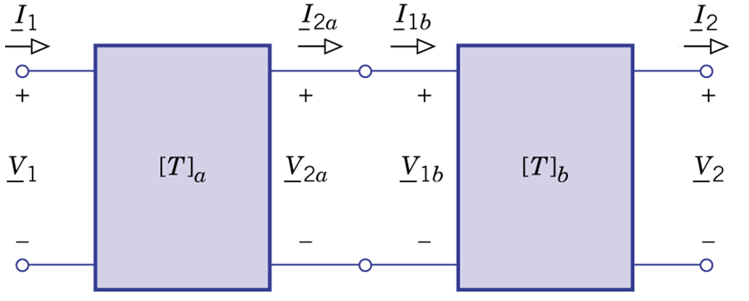
Cascade connection
The overall T parameters equals the product of the individual T parameters.
Notes:
Can we really do that

Slide 27
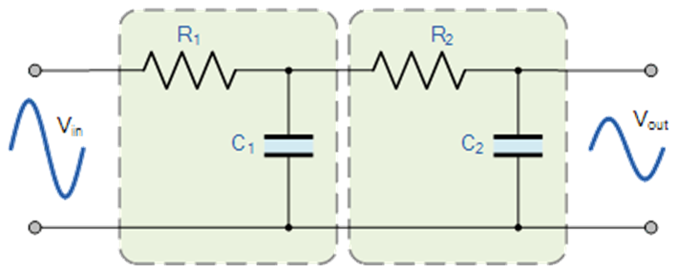
Cascade connection

Slide 28
Cascade connection

Slide 29
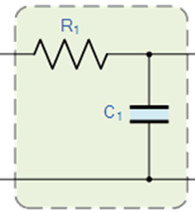
Cascade connection

Slide 30
Cascade connection

Slide 31
This Friday
練習 2011 的考古題
記得帶計算機
每次放一個題目在前面的投影片上
在限定時間內算出答案(可開書、可討論)
隨機點一位同學公布答案
Notes:
要準備考卷

Slide 32
Thank you!

Slide 33
Acknowledgement
感謝 張桓誠(b02)
上課時指出投影片的錯誤

Slide 34
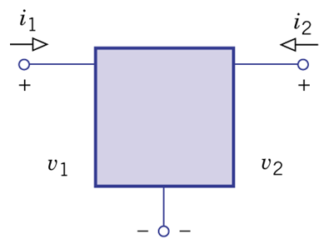
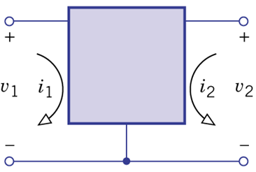
Three Terminal to Two Port

